Slide 1
How to use the TIMESTAMPDIFF parameter to perform a mathematical operation on two columns in an Alma Analytics report
Yoel Kortick | Sept. 2024

Slide 2
Introduction
Applying the TIMESTAMPDIFF filter on two dates
Applying the TIMESTAMPDIFF filter on two dates with an average

Slide 3
Introduction

Slide 4
Introduction
There may be cases where the library has created a report with two date columns and then wants to further process the two columns by performing an additional mathematical operation on them.
In the case here the library has a report of items including the PO Line send date and the item receiving date

Slide 5
Applying the TIMESTAMPDIFF filter on two dates

Slide 6
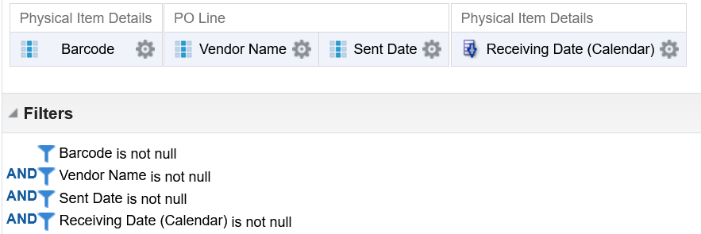
Applying the TIMESTAMPDIFF filter on two dates
In this example we will make a report in the physical items subject area and include the
  Barcode and Receiving Date from the Physical Item Details
  Vendor Name and Sent Date from the PO Line

Slide 7
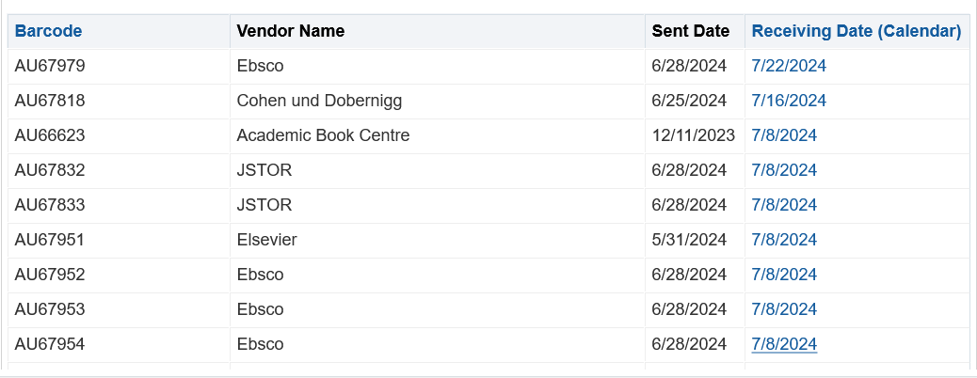
Applying the TIMESTAMPDIFF filter on two dates
Here is the report now

Slide 8
Applying the TIMESTAMPDIFF filter on two dates
We can then say as follows:
Send date – Receiving Date = days it took to arrive from time of sending
By including the vendor in the report, we can see which vendors take more or less time and thereby make strategic decisions regarding which vendors to use

Slide 9
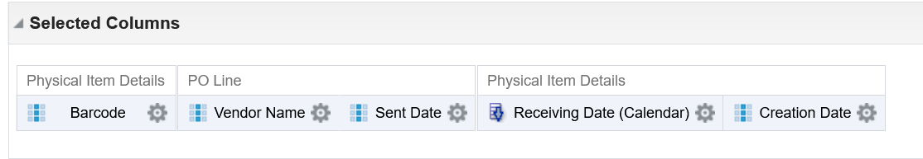
Applying the TIMESTAMPDIFF filter on two dates
We will first add a new field in the criteria tab. It can be any field. It does not matter what the field is because we will soon change the formula of the field.
The field will merely act as a "placeholder".
In our example we have added "Physical Item Details"."Creation Date"

Slide 10
Applying the TIMESTAMPDIFF filter on two dates
On the placeholder field we will do "Edit Formula" and add the following formula:
TIMESTAMPDIFF(SQL_TSI_DAY,"PO Line"."Sent Date","Physical Item Details"."Receiving Date")
These are the parts of the formula:
  The TIMESTAMPDIFF gives the difference of two dates.
  The SQL_TSI_DAY gives the unit in days.
  The first value is the date from which you want to subtract
  The second value is the date to subtract.
  The comma separates the first and second value

Slide 11
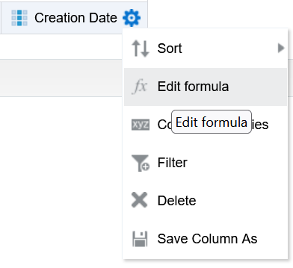
Applying the TIMESTAMPDIFF filter on two dates
Do "Edit formula" on the placeholder field

Slide 12
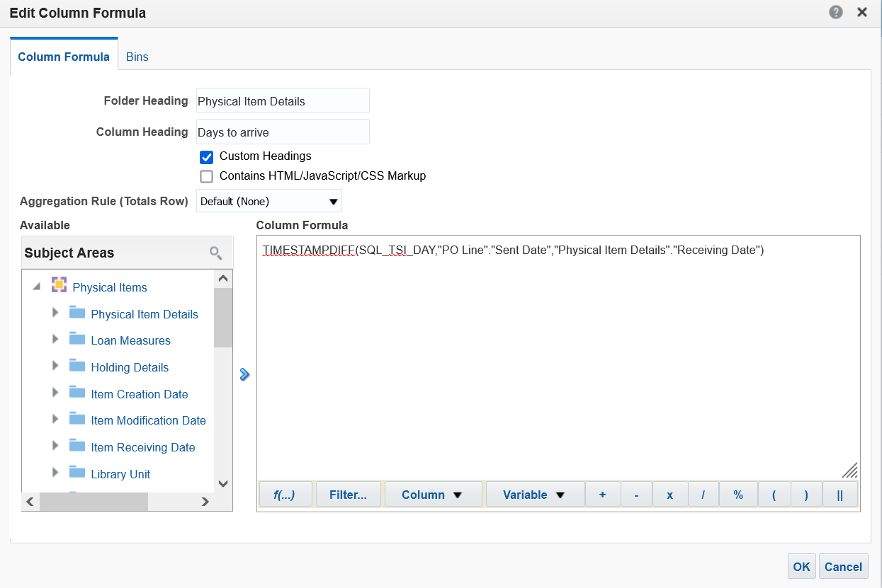
Applying the TIMESTAMPDIFF filter on two dates
Replace the existing formula with the new formula
We also changed the column heading

Slide 13
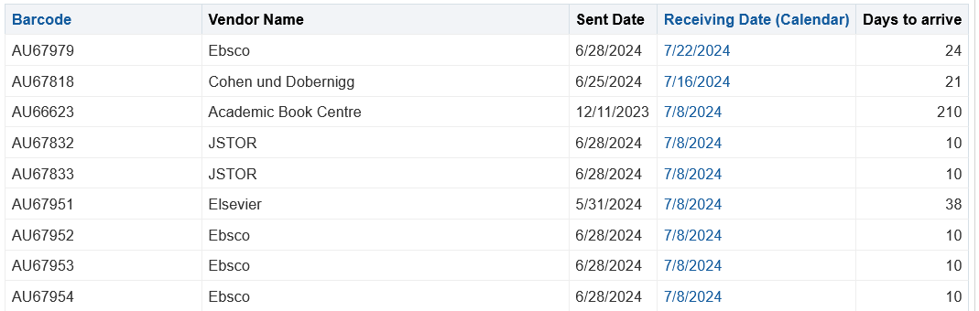
Applying the TIMESTAMPDIFF filter on two dates
View results
Sent June 28 2024.
Received July 22, 2024.
Took 24 days
Sent Dec. 11, 2023.
Received July 16, 2024.
Took 210 days
Sent June 28 2024.
Received July 8, 2024.
Took 10 days

Slide 14
Applying the TIMESTAMPDIFF filter on two dates with an average

Slide 15
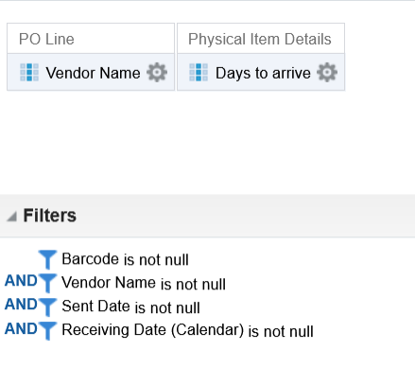
Applying the TIMESTAMPDIFF filter on two dates with an average
Now we have changed the report to have only "Vendor Name" and the "Days to arrive"

Slide 16
Applying the TIMESTAMPDIFF filter on two dates with an average
In order to get the Average Days to arrive we can change the formula from
TIMESTAMPDIFF(SQL_TSI_DAY,"PO Line"."Sent Date","Physical Item Details"."Receiving Date")
To
AVG(TIMESTAMPDIFF(SQL_TSI_DAY,"PO Line"."Sent Date","Physical Item Details"."Receiving Date"))
And we will remove the barcode, because now we want one average per vendor

Slide 17
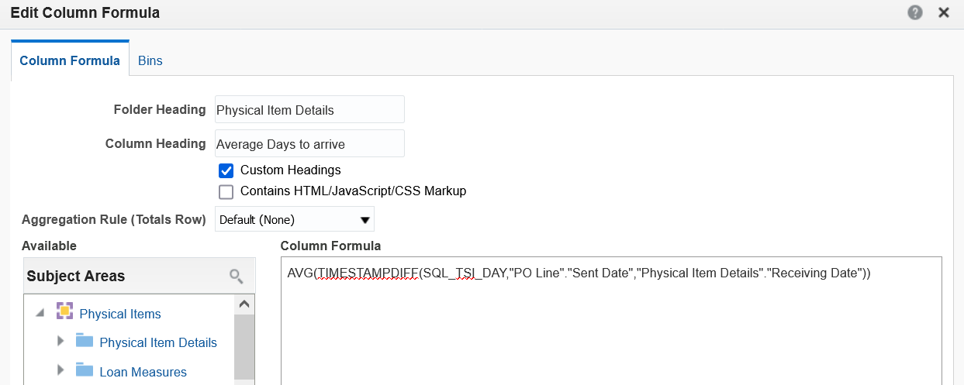
Applying the TIMESTAMPDIFF filter on two dates with an average
Here is the new "Edit Formula"

Slide 18
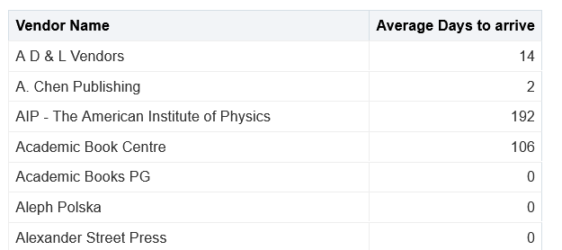
Applying the TIMESTAMPDIFF filter on two dates with an average
Here are the results

Slide 19
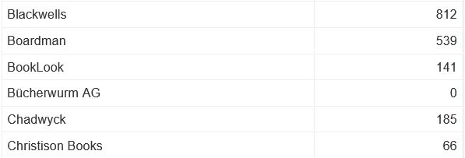
Applying the TIMESTAMPDIFF filter on two dates with an average
Let’s see for example why Vendor "Chadwyck" appears with an average of 185 days.

Slide 20
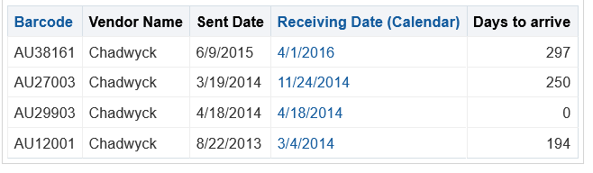
Applying the TIMESTAMPDIFF filter on two dates with an average
Vendor "Chadwyck" had four orders as follows.
The total days is 741
  297+250+0+194 = 741
The average is 185.25
  741 / 4 = 185.25

Slide 21
Thank You.
Yoel Kortick

